Slide 1

Intelligent Agents

Slide 2
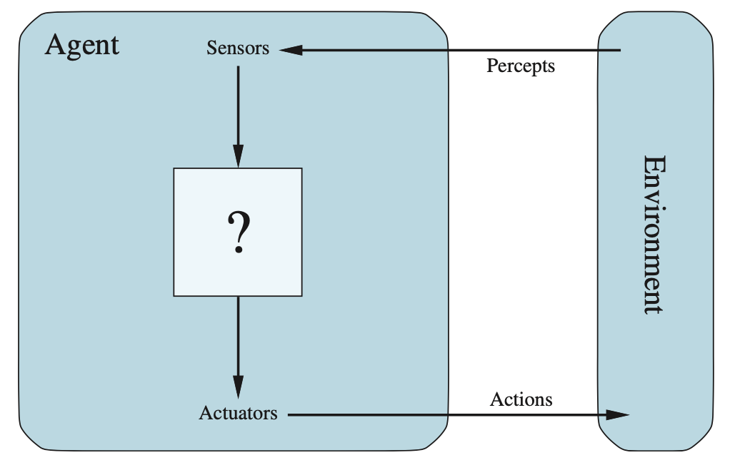
What Is an Agent?
A proposition is a statement that can be true or false
Propositional symbols represent facts about the world
Complex sentences are built using logical connectives
Examples:
Human: eyes/ears → brain → hands/mouth
Robot: cameras/sensors → processor → motors
Software agent: keyboard/file inputs → program → screen/network outputs

Slide 3

Agent Function
Agent Model
Abstract behavioral specification
Defines what the agent should do in every possible situation
Maps the percept history to an action
In theory, it could be represented as a lookup table
Concrete implementation
Runs on a real physical architecture
Approximates the agent function compactly and efficiently
All AI design is the search for good programs that approximate the ideal function
What we want to achieve
How we approximate it efficiently

Slide 4
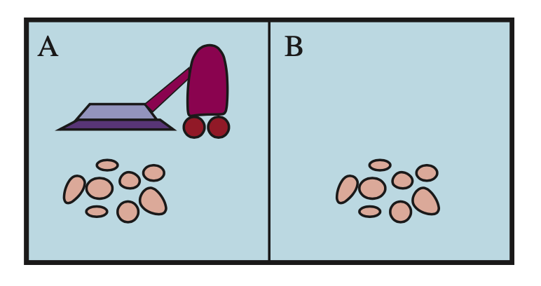
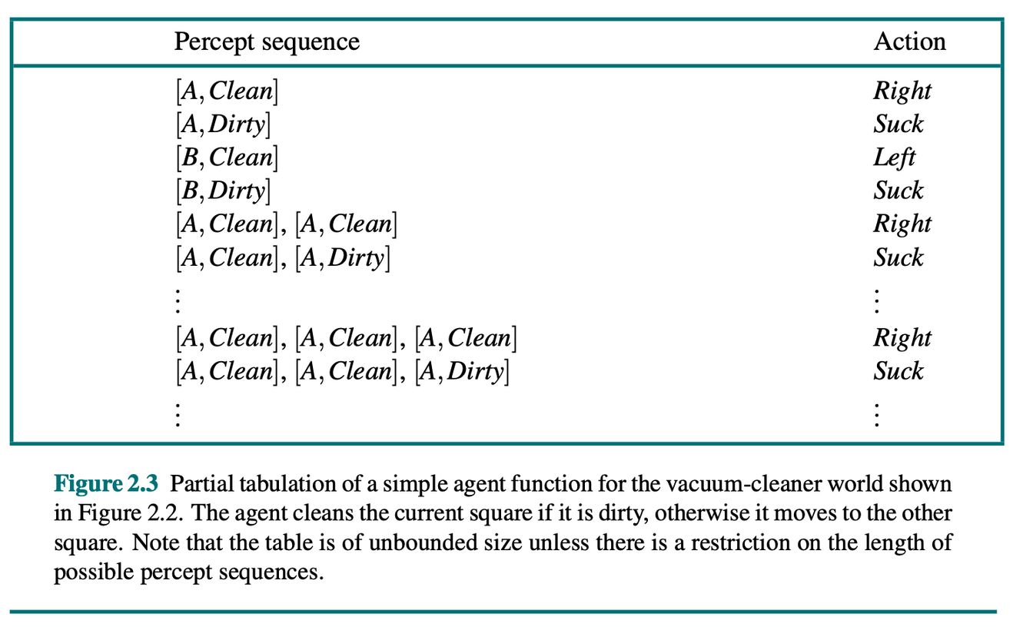
Agent Function
Vacuum World
Environment: 2 rooms (A and B), each of which may be dirty or clean
Sensors: current position + room status (dirty/clean)
Actuators: move left, move right, vacuum.
The space of percept histories grows exponentially with the number of variables and time
For a real agent, it is computationally intractable

Slide 5


Rationality
Performance Measure
Rational agent: at every moment, it selects the action that maximizes the expected value of a performance measure, given its percept history and built-in knowledge
Explore the environment to gather useful information
Learn from its percepts to improve future behavior
External criterion used to evaluate the success of the agent’s behavior.
It is defined by the designer, not by the agent
⚠️ Important: you get what you ask for... a poor measure produces unintended behavior
What happens if we specify it incorrectly...?
What if we do not specify everything?

Slide 6

PEAS
Performance — Success criterion
Environment — The world in which the agent operates
Actuators — Mechanisms for acting on the environment
Sensors — Mechanisms for perceiving the environment

Slide 7
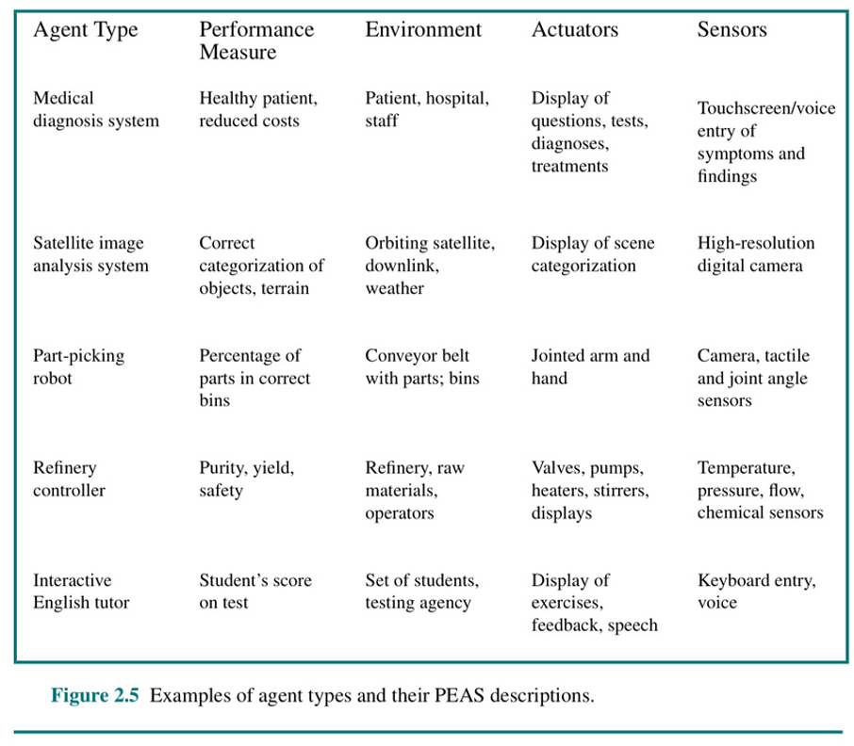

Slide 8

Environment
Fully Observable
Partially Observable
Can the agent access the complete state of the environment at all times?
Can the sensors detect the aspects relevant to choosing an action?
Does it need memory and state estimation?

Slide 9

Environment
Deterministic
Non-Deterministic
Given the same input, you always get the same output.
No randomness.
Stochastic Systems: Same input can give different outputs due to randomness.
Is the next state completely determined by the current state and the agent’s action?
Must uncertainty be handled?

Slide 10

Environment
Sequential
Episodic
Is each percept–action episode independent of the previous one?
Can current decisions affect future decisions?

Slide 11

Environment
Dynamic
Static
Does the environment change while the agent deliberates?
If it changes, the agent must act quickly.
Semidynamic: the environment does not change, but performance does (chess with a clock)

Slide 12
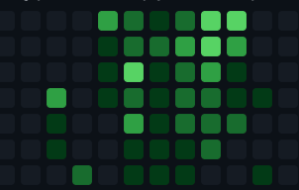

Environment
Continuous
Discrete
A finite number of well-defined states, percepts, and actions
Multi- Agent
Single Agent
They may be competitive or cooperative teammates

Slide 13
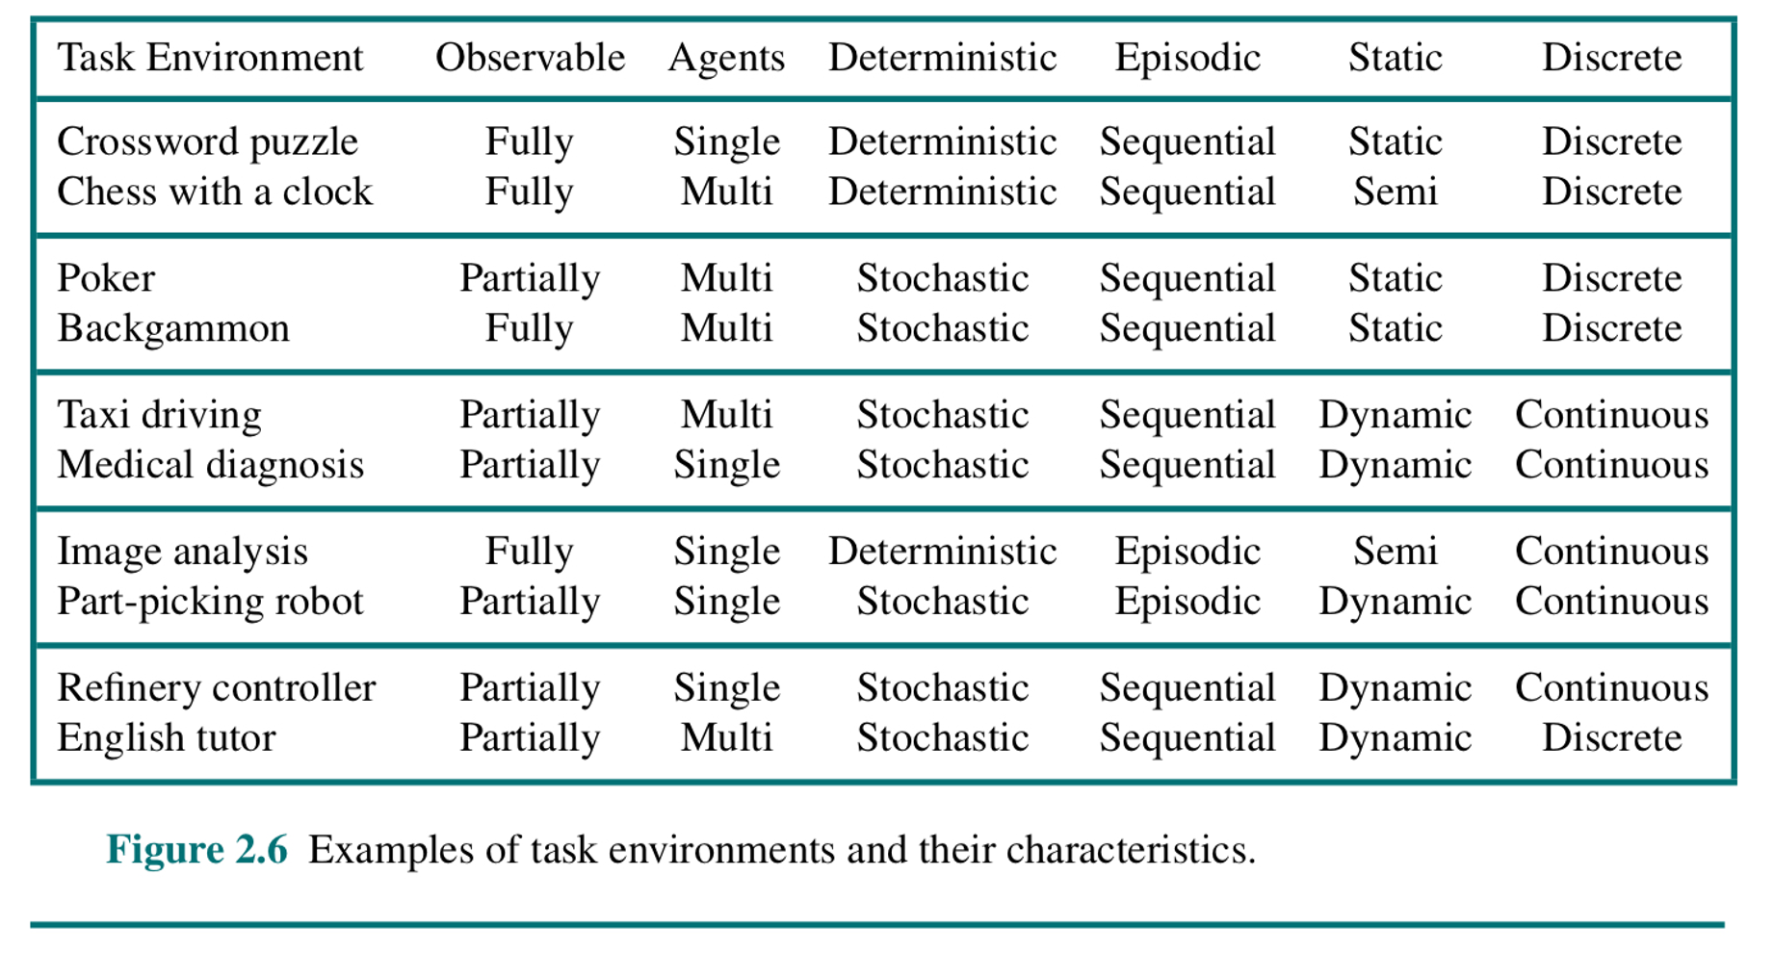

Slide 14
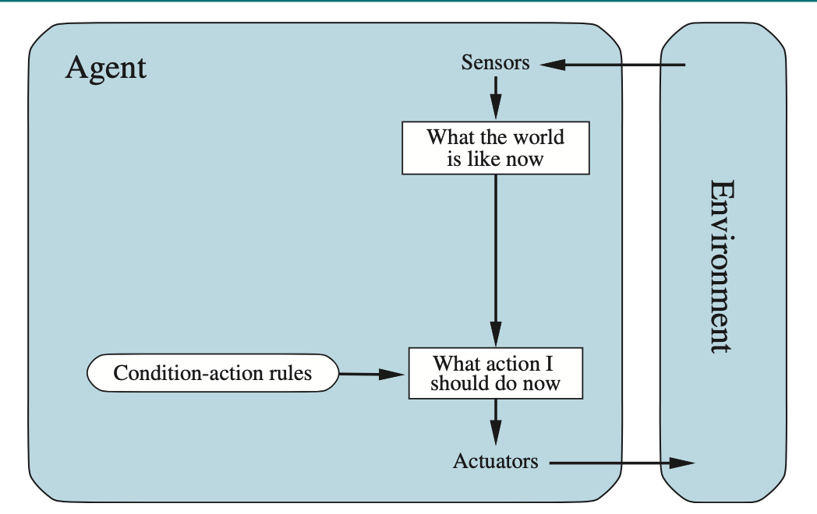
Agents
Simple Reflex Agent
Considers only the current percept, with no memory
Operates through condition–action rules
Advantage: simple and efficient to implement
Limitation: fails in partially observable environments; if it cannot see the complete state, it cannot act correctly
Works well only when the current percept contains all relevant information

Slide 15
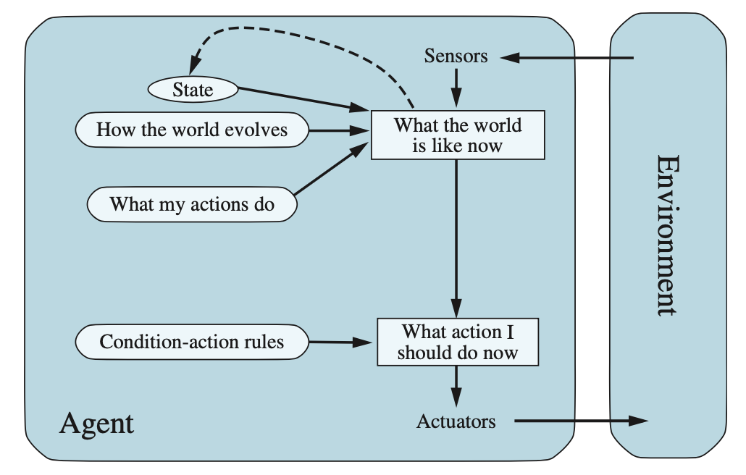
Agents
Model Based
Reflex Agent
Maintains an internal state using two models
World model: how the environment evolves independently of the agent
Transition model: how the agent’s own actions affect the environment
The agent updates its internal state at each step and then applies condition–action rules to that state
It can act coherently even when it cannot observe the complete environment

Slide 16
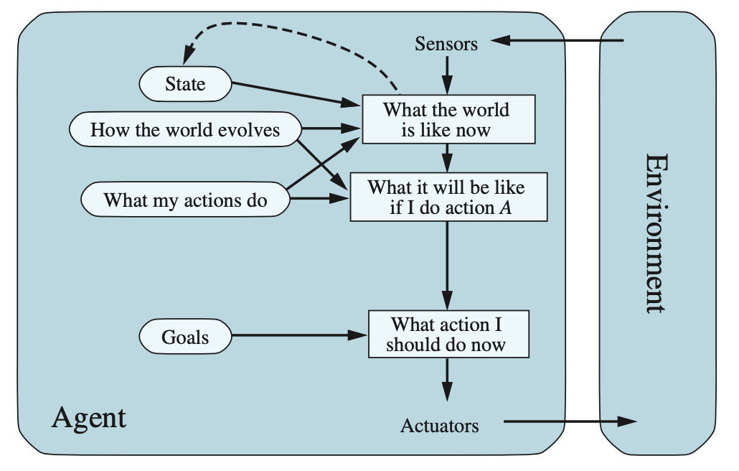
Agents
Goal Based Agent
It also needs to know where it wants to go
Goals describe desired states of the world
The agent chooses actions that move it toward the goal, which requires planning and search
It can adapt its behavior when the goal changes
Limitation: goals provide a binary distinction and cannot distinguish better from worse paths to the goal

Slide 17
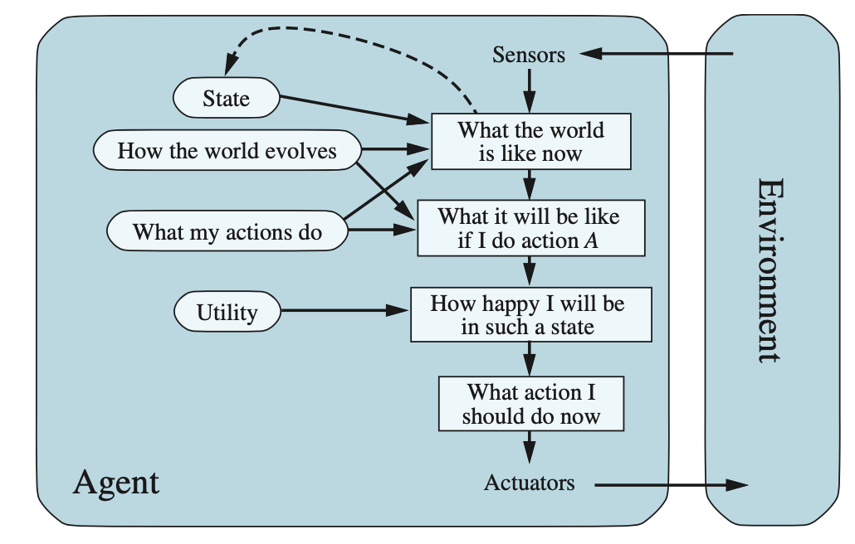
Agents
Utility Based Agent
Distinguishes among solutions of different quality.
Chooses the action that maximizes expected utility while considering outcome probabilities
Can handle:
Conflicting objectives: speed vs. safety in a taxi
Uncertainty: acting when the outcome of an action is not guaranteed

Slide 18
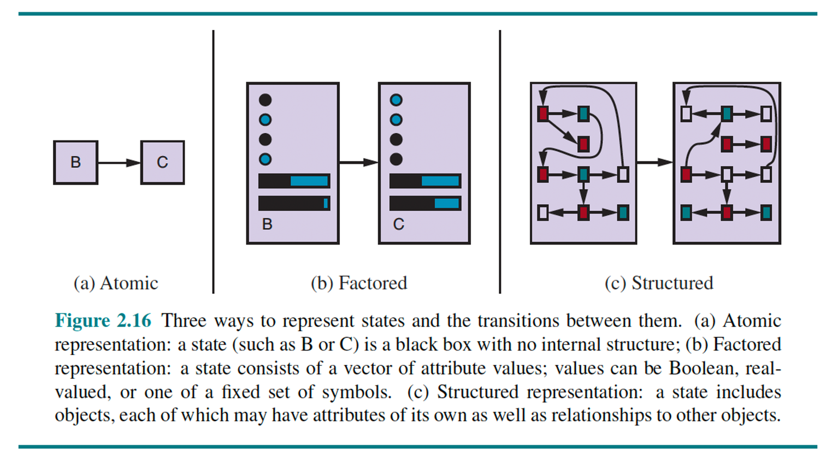
State Representation
Why is the level of representation important?
Greater expressiveness enables more reasoning, but also increases computational complexity
Atomic: each state is an indivisible black box with no internal structure
Factored: described by a set of variables/attributes with values
Structured: describes objects and the relationships among them

